Slide 1
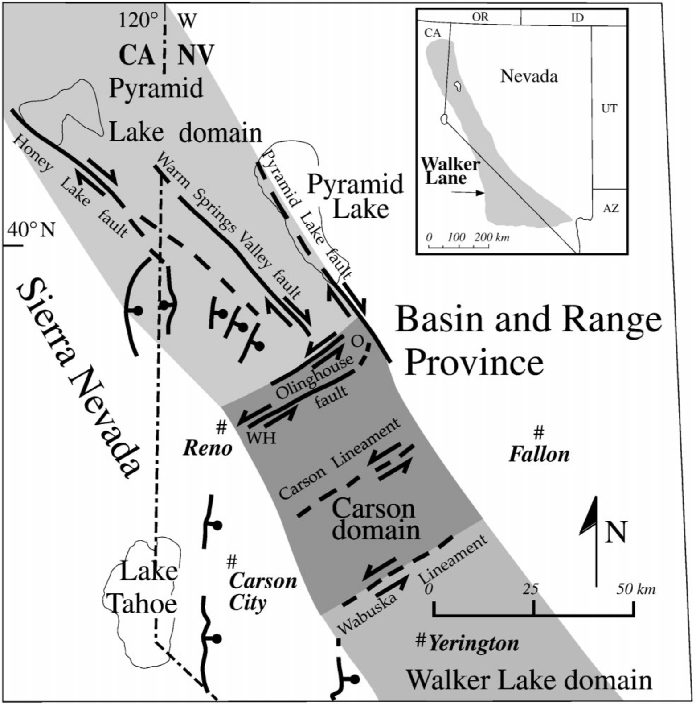
Strain partitioning in the northern Walker Lane, western Nevada and northeastern California
Patricia H. Cashman and Sheryl A. Fontaine 2000
Presented by Luke J. Schranz

Slide 2
The Problem
“The timing and style of faulting (in the northern Walker Lane) is not as well understood as it is in the central Walker Lane”
An explanation of the mechanism for transmitting northwest directed dextral slip across the Carson domain
no major northwest-striking faults
?

Slide 3
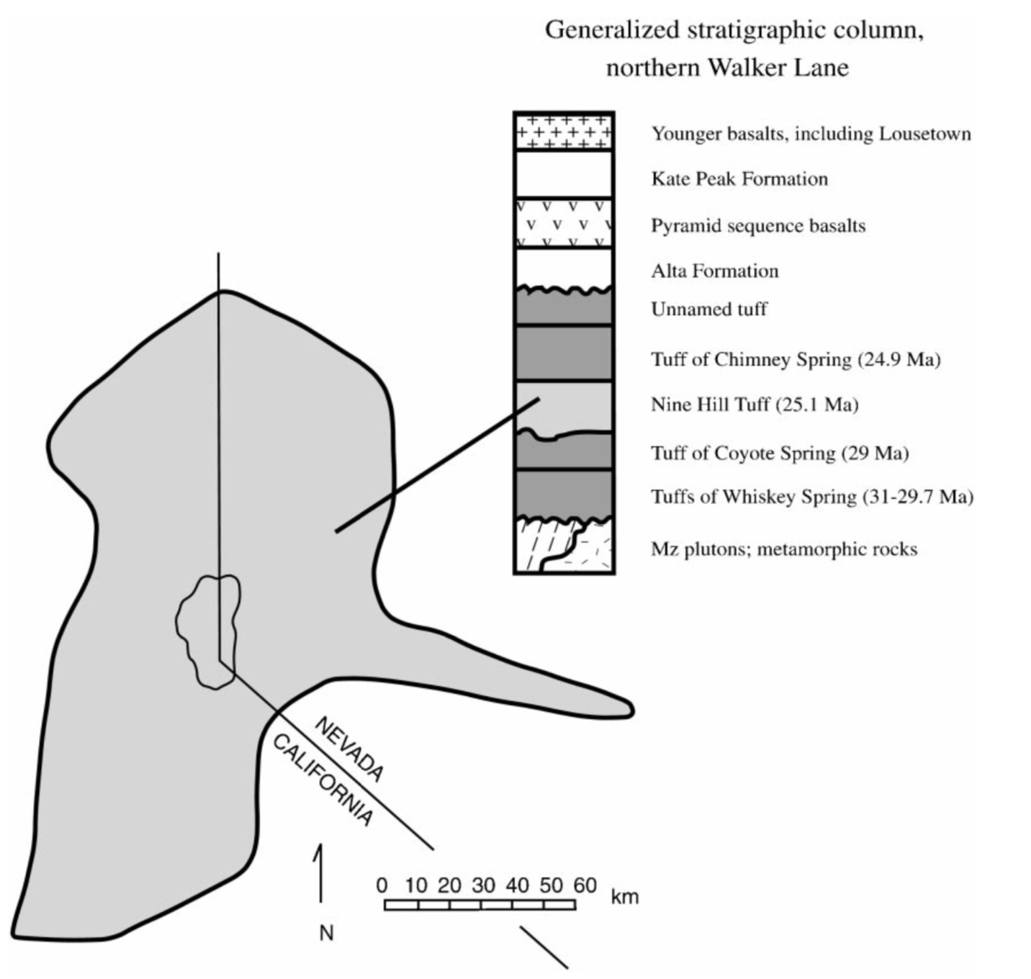

Slide 4
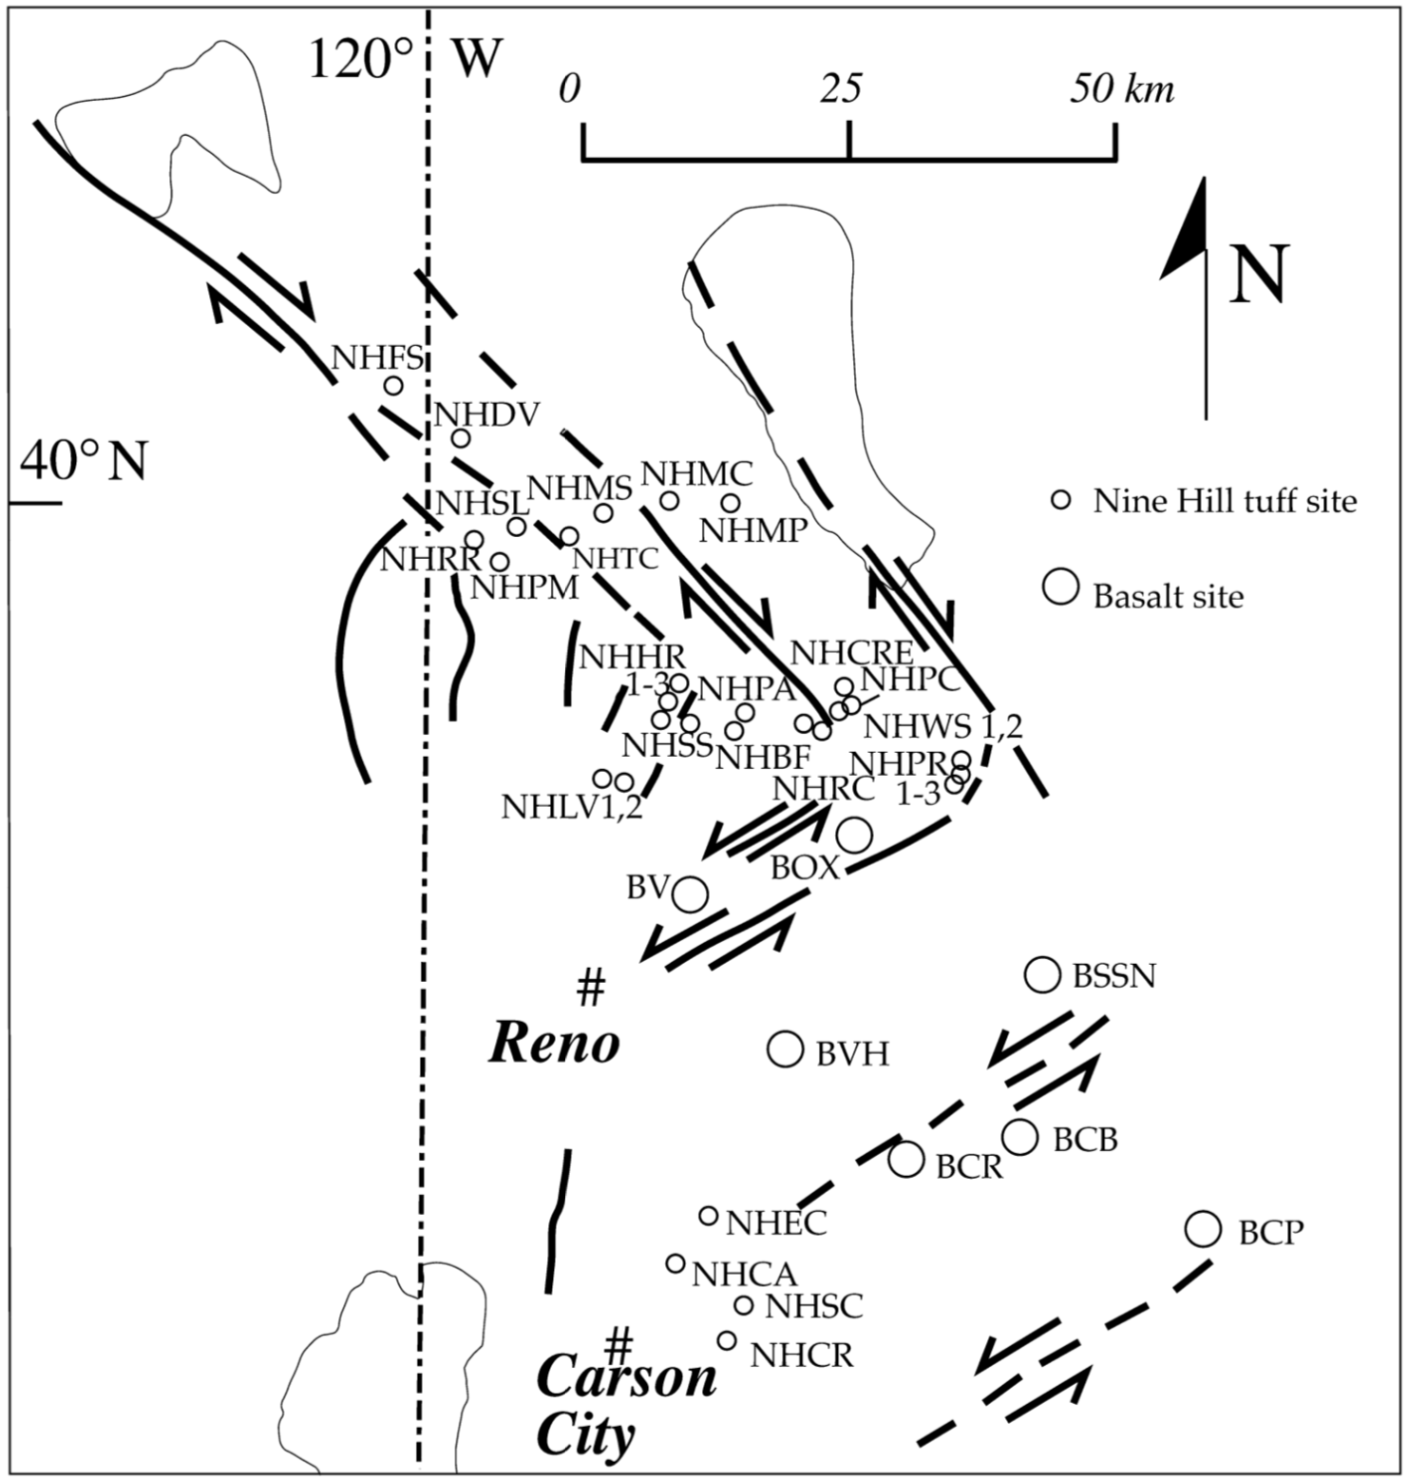
Data - Paleomag from 17 sites

Slide 5
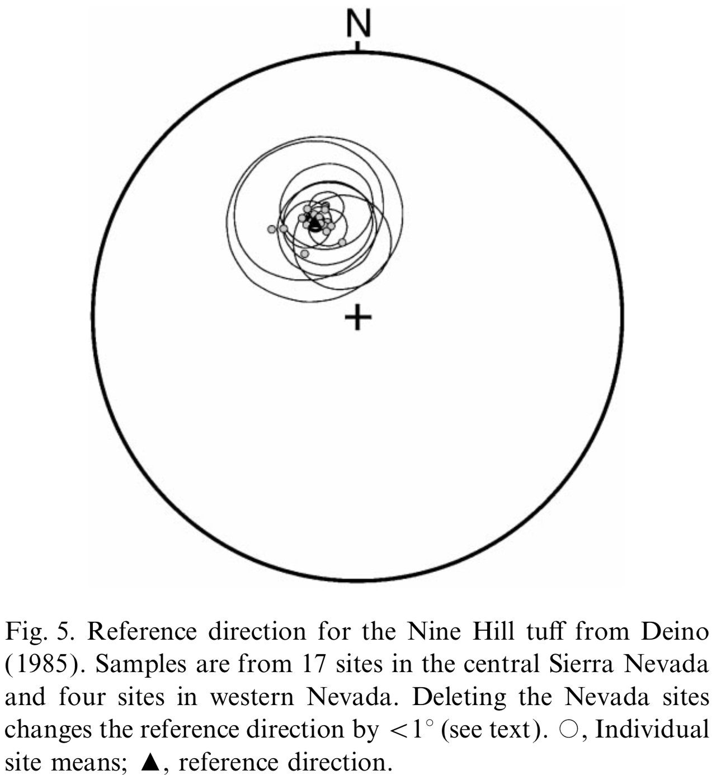
Paleomag reference direction for Nine Hill tuff
“The reference direction for the Nine Hill tuff was determined primarily from localities in the central Sierra Nevada, not the Walker Lane; paleo- magnetic studies of the Nine Hill tuff in the Walker Lane therefore measure tectonic rotations relative to the Sierra block.”

Slide 6
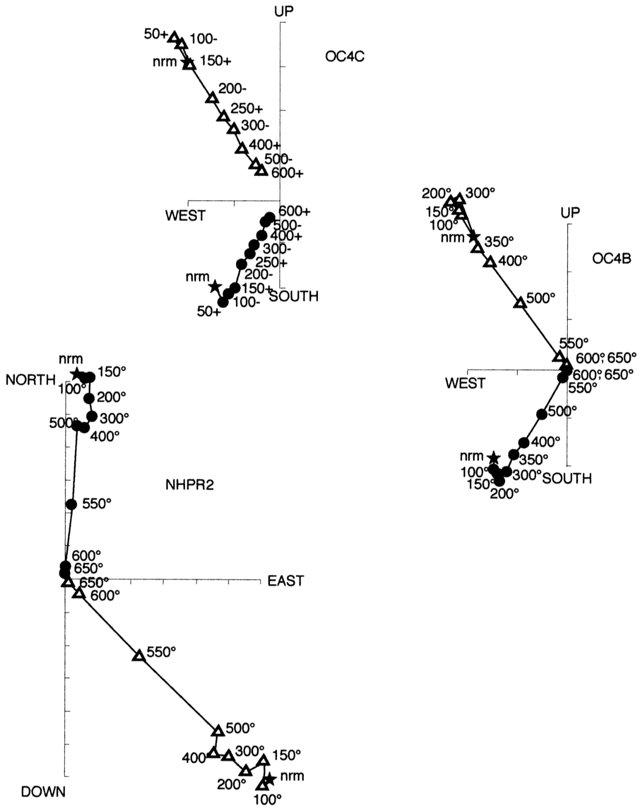
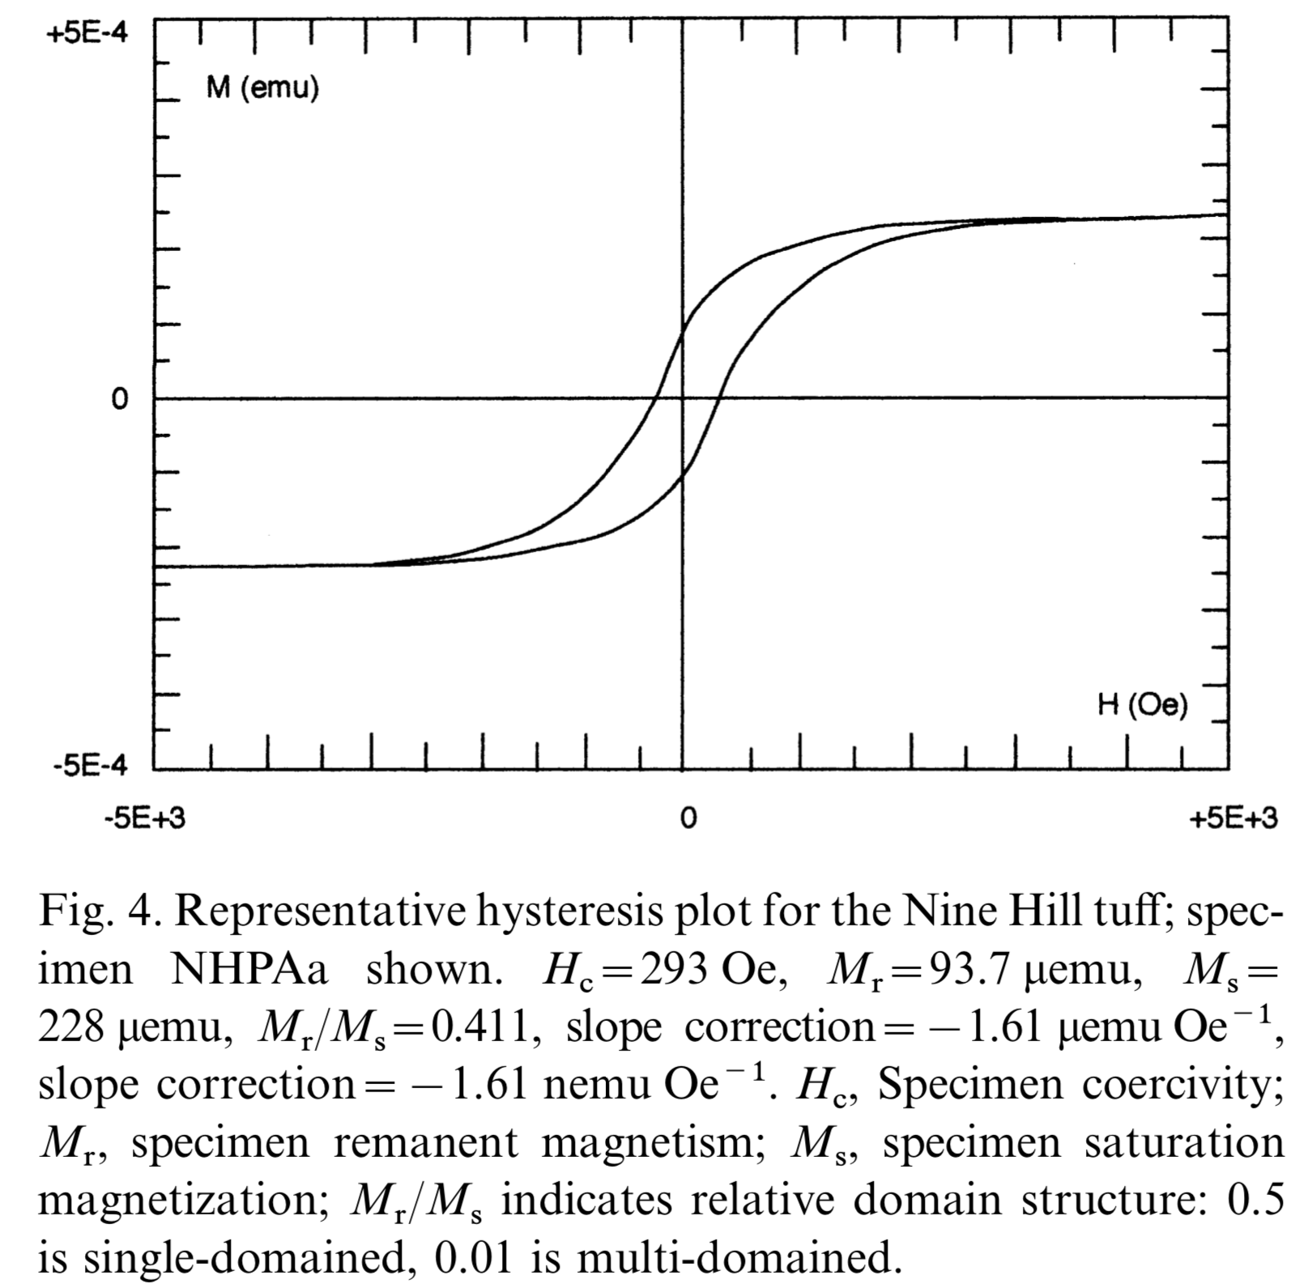

Slide 7
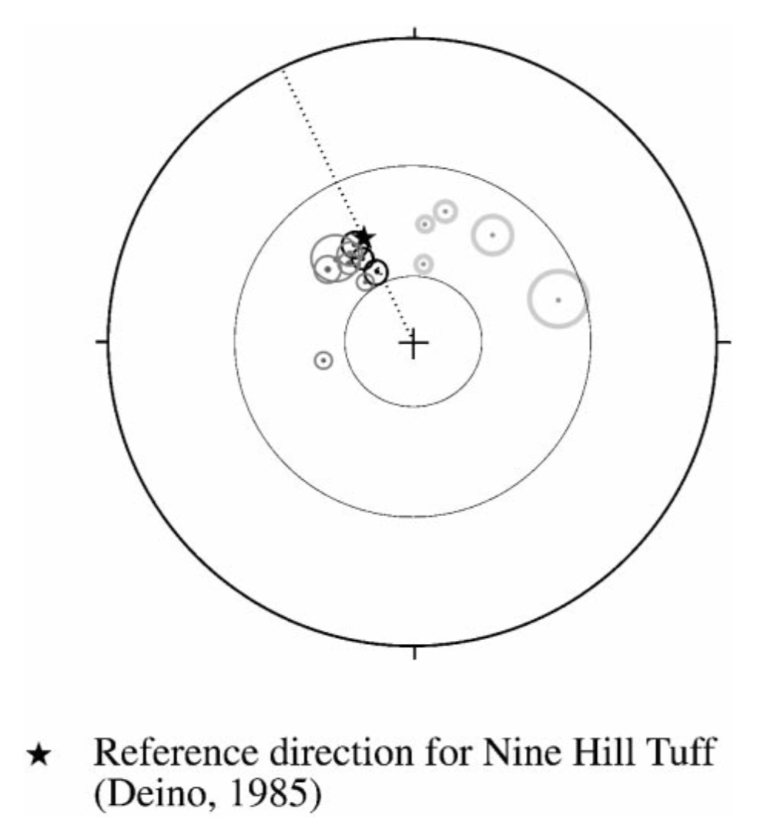
Pyramid Lake domain Nine Hill tuff
CW rotated sites are near domain-defining dextral faults
CW rotation attributed to drag along faults

Slide 8
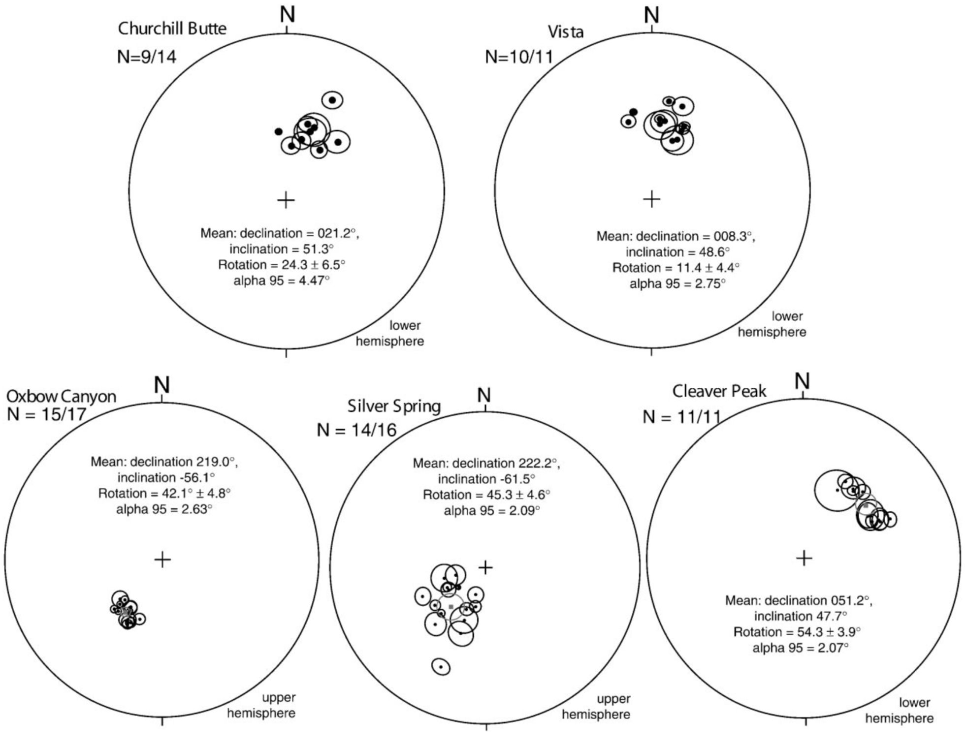
Carson domain basalts

Slide 9
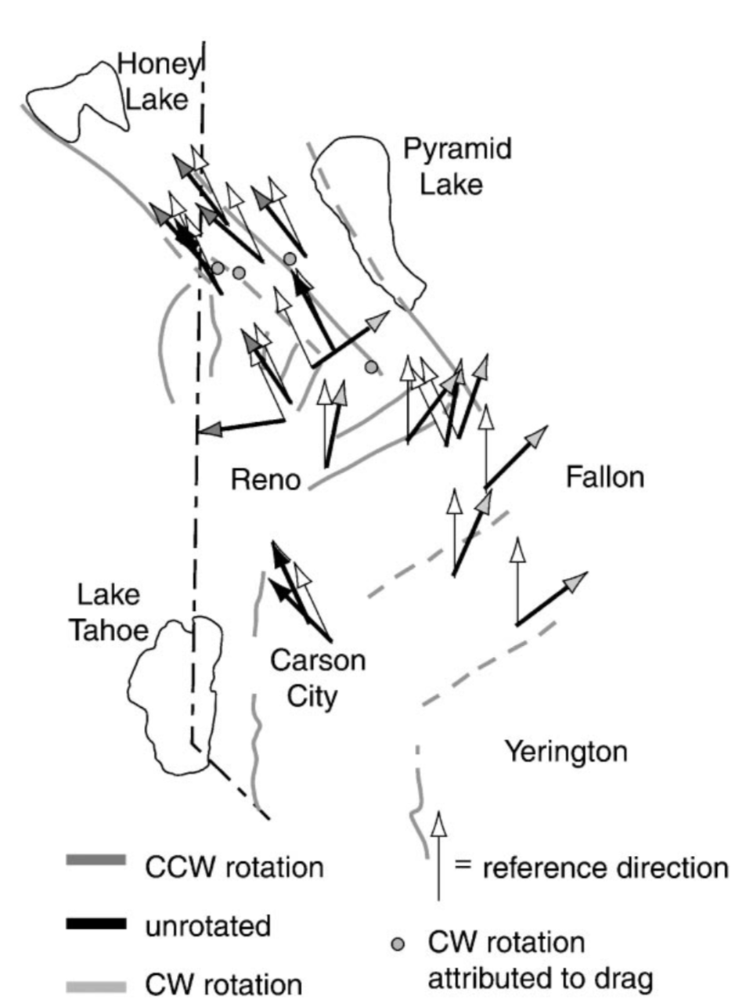

Slide 10
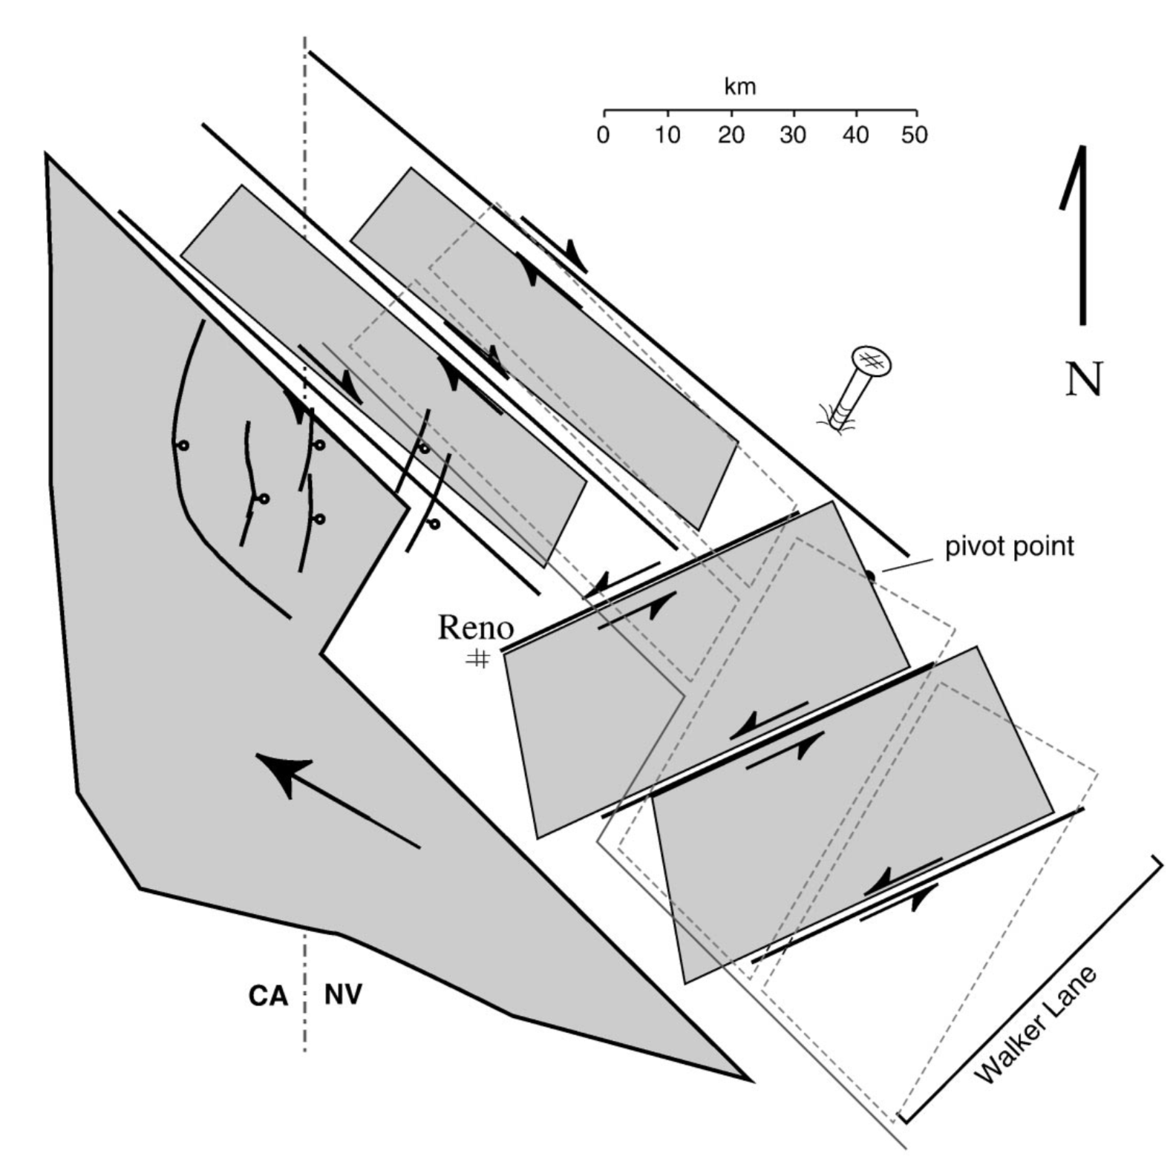

Slide 11
Interpretations
Carson domain Nine Hill tuff and younger, 13-9 Ma basalts is nearly identical
All rotation in Carson domain is post 13-9 Ma
Other studies have documented multiple episodes of deformation throughout Walker Lane
Attributed to Pacific-North American plate boundary interactions - San Andreas transform beginning to influence basin and range extension ca. 10 Ma
“It is clear that the ultimate solution will incorporate both the current deformation and studies of Neogene and older rocks, which extend the kinematics back in time. Paleomagnetic studies add the unique measure of vertical-axis rotation to our understanding of the structural evolution.”

Slide 12
Questions

